Slide 1
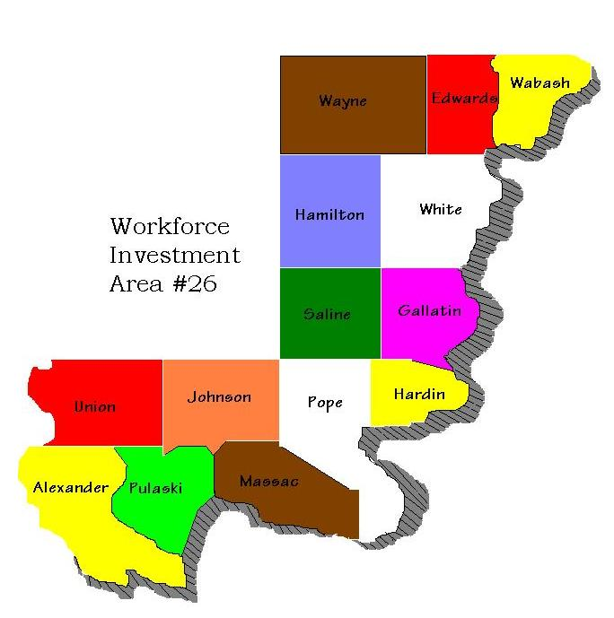
Southern 14 Workforce Investment Board

Slide 2
Time To Make a Change? Training and Supportive Services To Help Make You Successful.

Slide 3
Not Interested in Traditional Classroom Training? NO Problem…
We offer earn while you learn paid hands on work-based learning options to help you succeed.

Slide 4
This change effects your whole family…
Maybe your spouse is interested in beginning or re-entering a career…We are here to help them as well.
Supporting someone in college? Mention it to your career planner. We may have resources to help there too.

Slide 5
PROUD TO SERVE…
Those who have served!
Priority of Service to
Veterans and
Eligible Spouses

Slide 6
You are not alone…We are here to help!
If you live in… Edwards, Gallatin, Hamilton, Saline, Wabash, Wayne, or White counties your contact will be Wabash Area Development.
They can be reached at 618 963 6187.
If you live in… Alexander, Hardin, Johnson, Massac, Pope, Pulaski or Union counties your contact will be Shawnee Development Council.
They can be reached at 618-634-2201.

Slide 7
You are not alone…We are here to help!
If you live in… Franklin, Jackson, Jefferson, Perry or Williamson counties your contact will be Man-Tra-Con Corporation.
They can be reached at 618-998-0970.
If you live in any other county or are not an Illinois resident you can find the office nearest to you at www.ilinoisworknet.com or you can always call my office at 618-382-5024.

Slide 8
Still just aren’t sure where you want to go from here, don’t worry.
I encourage you to contact one of our office no matter what your next step might be…
This Photo by Unknown Author is licensed under CC BY-NC

